Slide 1

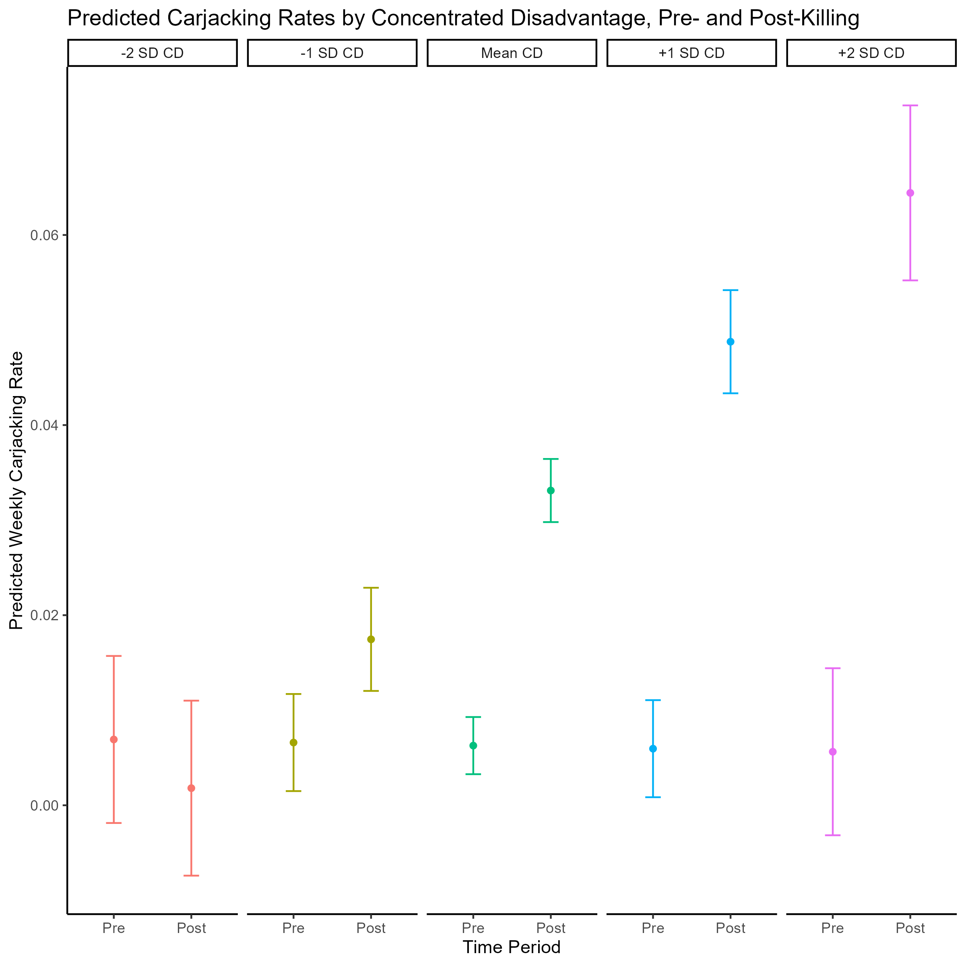
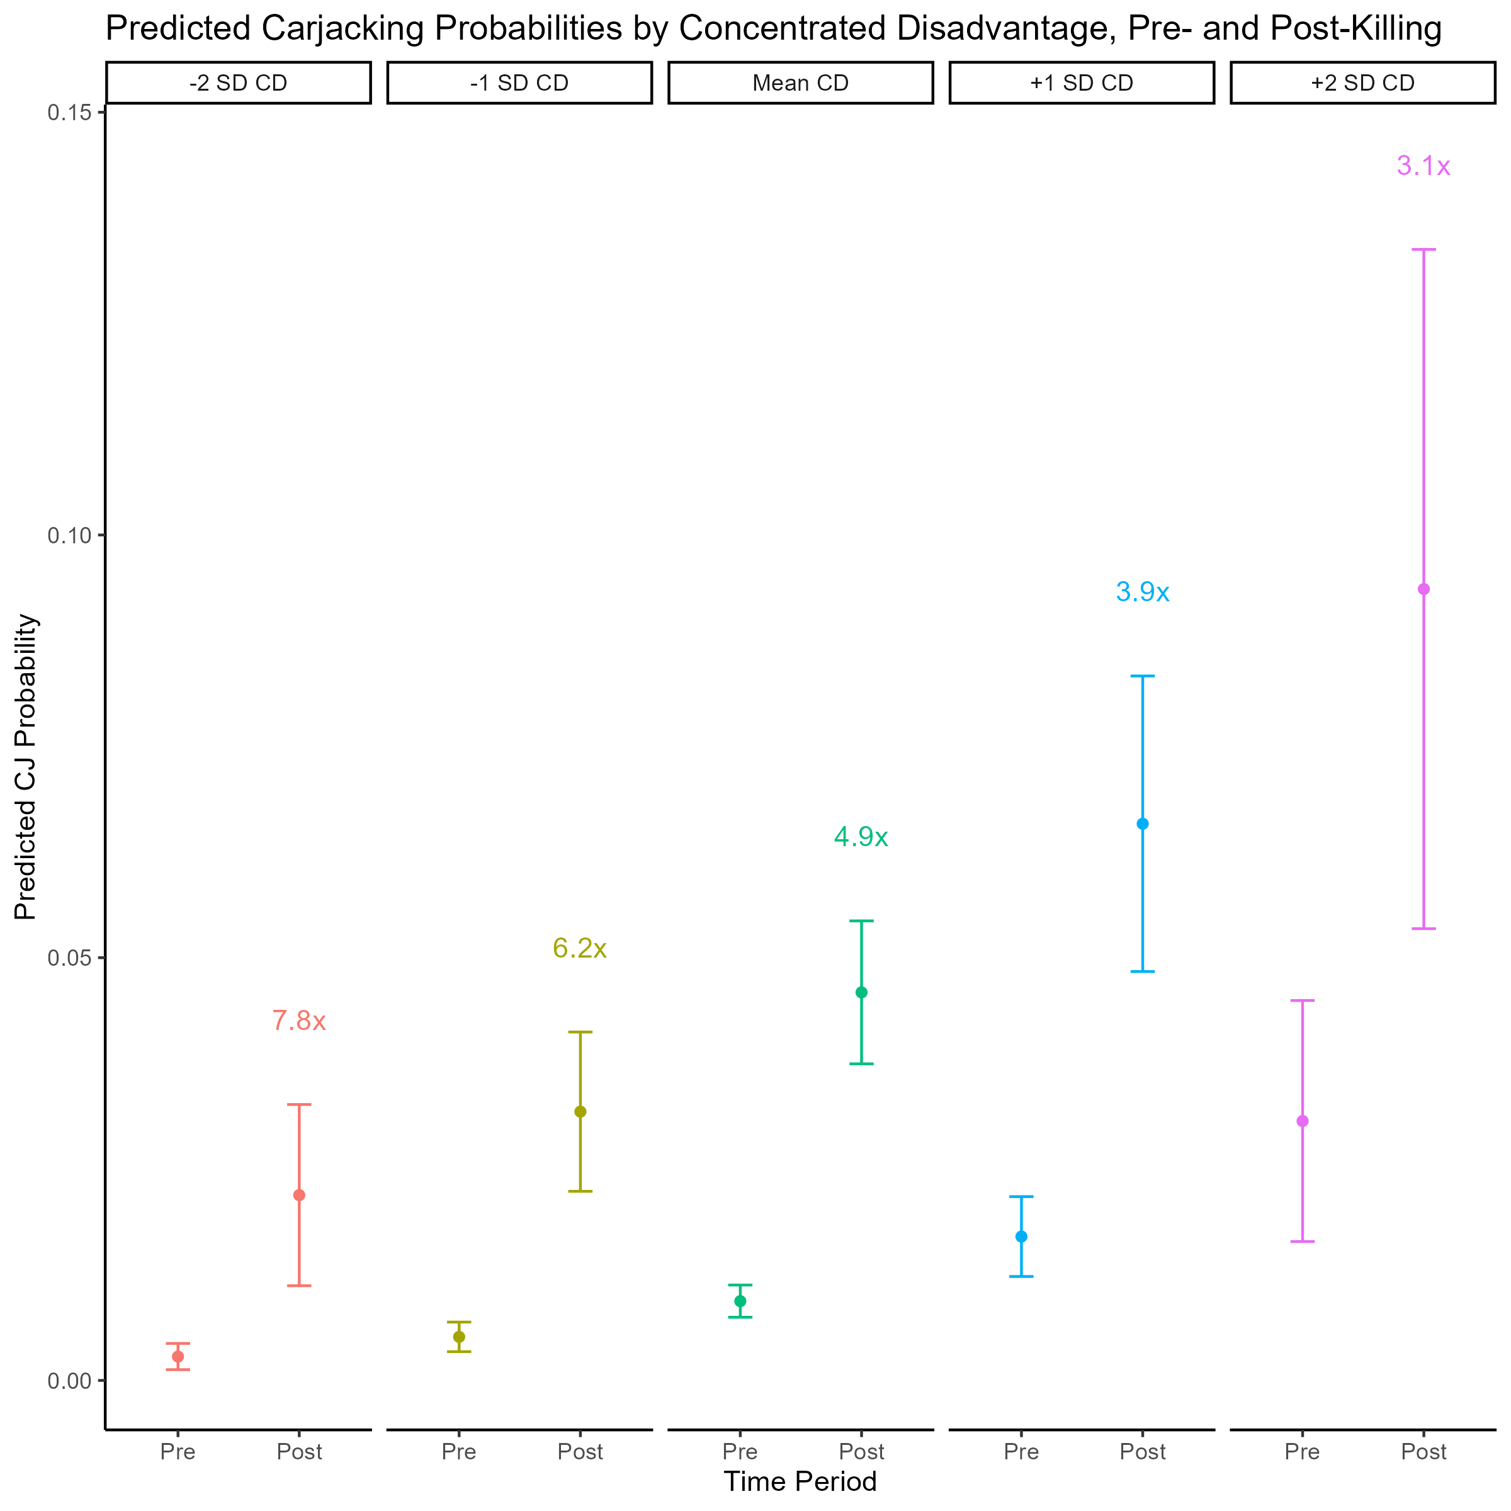
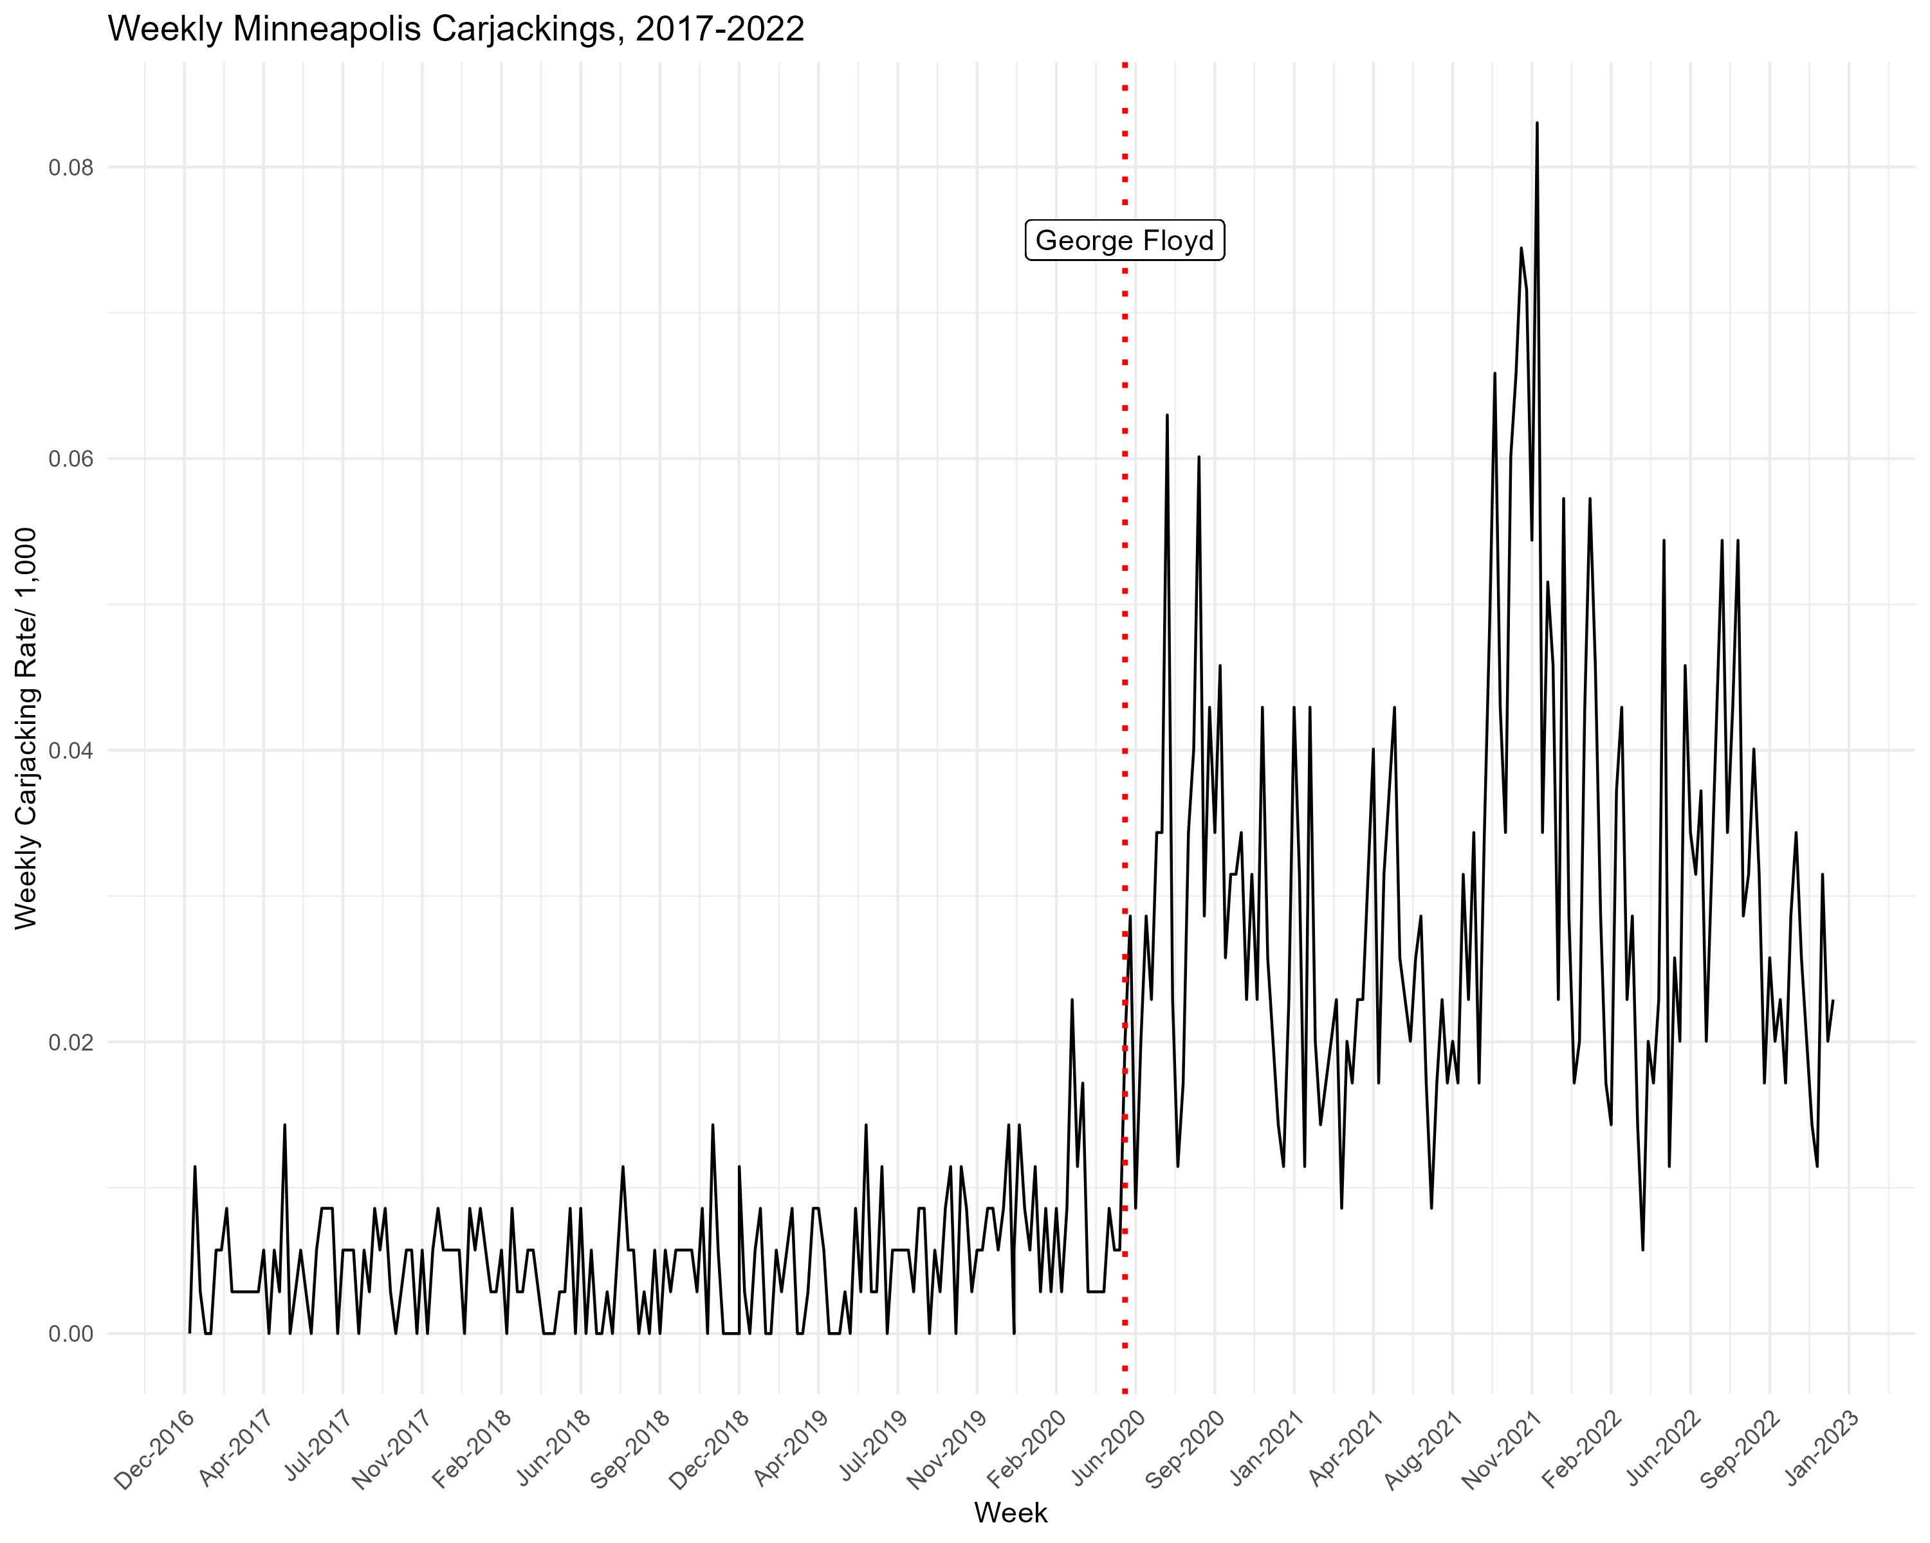
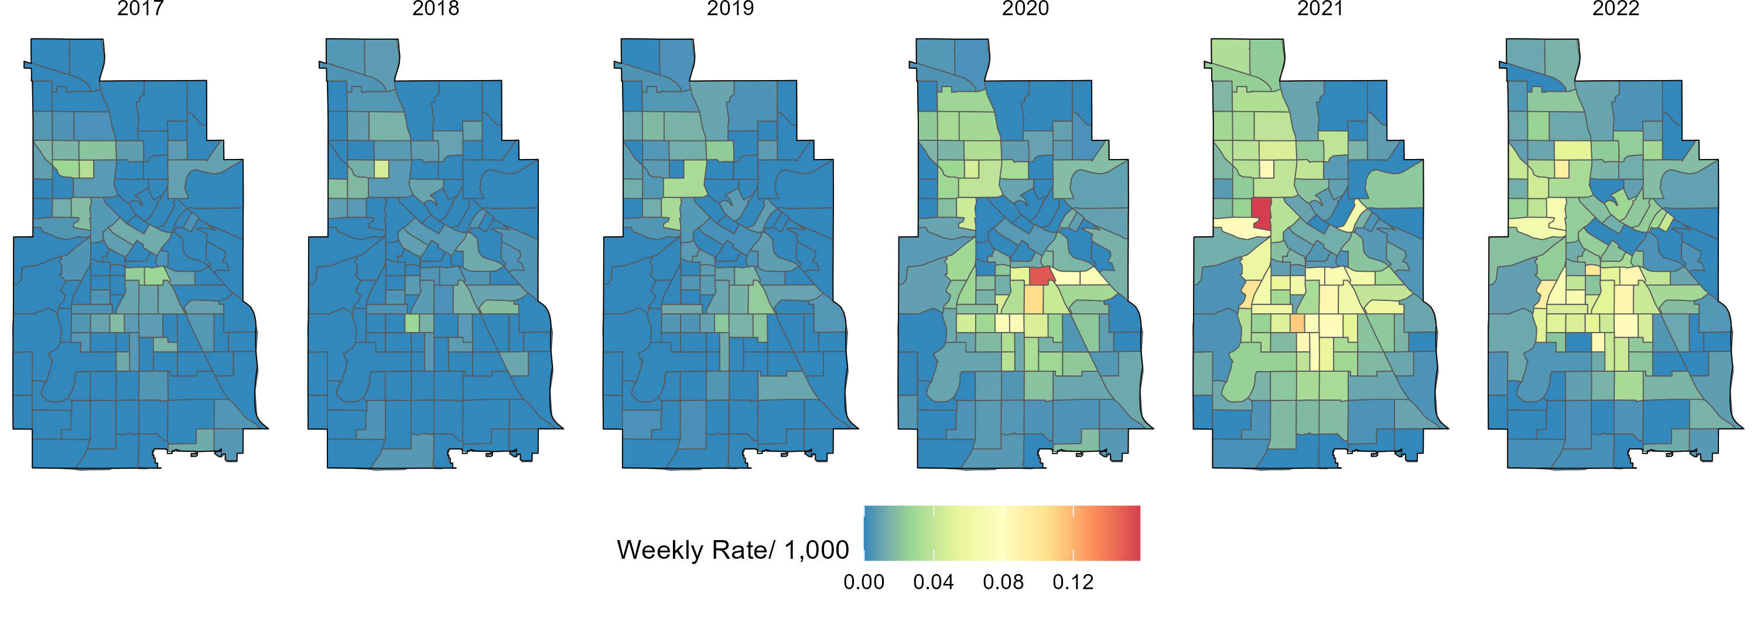

A Spatio-Temporal Analysis of Carjackings & Neighborhood Disadvantage
Allison Lind, Susan Mason, Chris Uggen, University of Minnesota, Twin Cities
Ryan Larson, Hamline University
Highlights
Carjackings dramatically increased in Minneapolis after
the police killing of George Floyd
Disadvantaged Neighborhoods saw a larger increase in carjackings BUT Advantaged Neighborhoods saw a greater relative change
Community violence and crime negatively impact health and are important drivers of inequities
Violent crime has increased in urban areas since 2020 with carjackings of interest to the media
We examine the spatio-temporal patterns of carjackings in Minneapolis 2017-2022 in comparison to the well-established patterns for homicides
Carjackings remain concentrated in disadvantaged neighborhoods. However, they dispersed to advantaged neighborhoods, which may influence media attention
Prior to the murder of George Floyd, the average weekly rate was 0.0048 carjackings per 1,000 residents
Afterwards, the average weekly rate increased 528% to 0.030
Homicides did not see as large or as sustained of an increase as carjackings
Minneapolis Weekly Carjacking Rate, 2017-2022
What we know on recent violent crime trends comes from gun violence
Gun violence has increased since 2020 though it continues to cluster in disadvantaged neighborhoods, just at higher rates
Are carjackings, like gun violence, clustering in socially disadvantaged neighborhoods? Or are they occurring in neighborhoods with higher levels of collective efficacy and political connectedness?
Carjackings dispersed to much of the city in 2020
Post-killing, the carjacking rate was higher in more disadvantaged neighborhoods
A larger relative increase in advantaged neighborhoods may help explain media attention
Implications and Future Research Directions
Data and Analysis
Carjacking rates higher in disadvantaged neighborhoods
Increased violence exposure
City of Minneapolis Police Department Data on carjackings and homicides, 2017-2022
IPUMS USA for 2020 census tract-level characteristics & population estimates
Analysis:
Describe carjacking spatio-temporal patterns
Random effects models to examine neighborhood-level predictors of carjackings (carjacking as continuous outcome & then what predicts a tract going from 0 to any carjackings)
Negatively impact communities of color and perpetuate inequities
Does where a carjacking occur influence criminal charging?
Does carjacking location influence media reporting?
Advantaged neighborhoods more likely to go from 0 to any carjackings
Punitive criminal justice reform
Prior to 2020: Carjackings occurred in Minneapolis but at lower rates and clustered in disadvantaged neighborhoods
2020 and 2021: Dispersed to much of the city with hotspots in disadvantaged neighborhoods
2022: Contracting, but rates remain high
This dispersion was not observed with homicides

